Slide 1
Mct2 Automation
Notes:
1
1
1
1

Slide 2
Cédric Lenoir
Cedric.Lenoir@hevs.ch
Bureau 23N.412

Slide 3
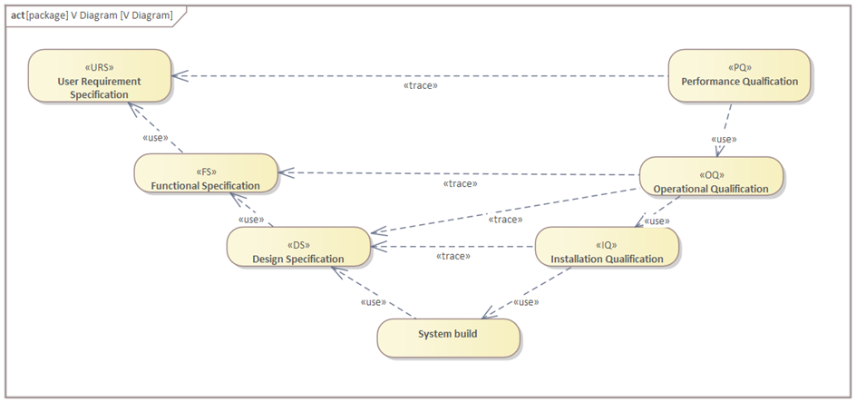
Principes généraux
8- HMI
1- Assurance qualité
6- Sécurité OT
7- Sécurité machine
10- Maintenance
2- S-88 & PackML
12- Decommissioning
Connaissance
Jugement
Application
3- IEC 61131-3
9- Alarmes
4- Réseau OT
5- OPC UA
11- Industrie 5.0

Slide 4


IEC 61131 structured text vs Java
public class MyProgram
{
//Program entry point
public static void main(String[] args)
{
int var1=3;
int var2=4;
var1 = var1 + var2;
}
}
DATA_BLOCK "DB_Learn"
NON_RETAIN
VAR
var1 : Int;
var2 : Int;
END_VAR
BEGIN
var1 := 3;
var2 := 4;
END_DATA_BLOCK
Target audience
For people with previous knowledge of Java.
In the context of HES-SO of Valais basis Inf1_2122 by Pierre-André Mudry.
"DB_Learn".var1 :="DB_Learn".var1 + "DB_Learn".var2;
Notes:
4
4
4
4
4

Slide 5
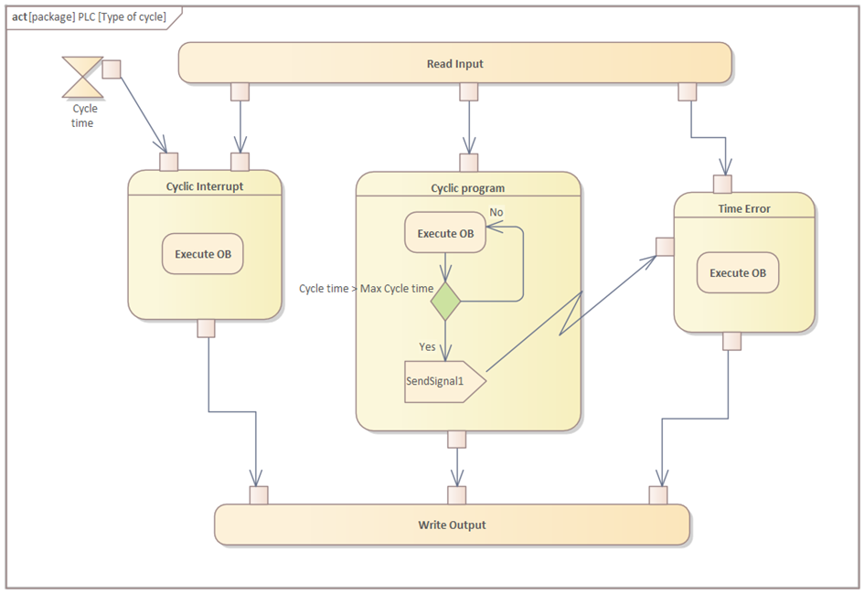

Cyclic Interrupt, Cyclic, Interrupt

Slide 6

Interrupt vs Cyclic
Java
IEC 61131
Program starts once.
Standard programs are cyclic

Slide 7
Types
Java
IEC 61131
boolean 1 bit
char 2 byte
byte 1 byte
short 2 byte
int 4 byte
long 8 byte
float 4 byte
double 8 byte
Bool 1 bit
Char 1 byte
WChar 2 byte
Byte 1 byte
Sint 2 byte
Int 4 byte
Dint 8 byte
Real 4 byte
LReal 8 byte
Not interesting to use short forms if processor has 64 bits…
Excepted, maybe for fast communication in real-time.

Slide 8
Base 2 – 10 - 16
Java
IEC 61131
// Binary diVar1 = 0b101;
// Decimal
diVar2 = 1234;
// Hexadecimal
diVar3 = 0xAB34;
// Binary diVar1 := 2#101;
// Decimal
diVar2 := 1234;
// Hexadecimal
diVar3 := 16#AB34;
Note the difference for assignation
Java “=“ IEC -61131 “:=“

Slide 9
Comments
Java
IEC 61131
// comments
/* comments */
/** * comments */
// comments
(*
other comments
*)

Slide 10
Variable Scope
Java
IEC 61131
The scope of a variable starts at its declaration and ends when the block is finished.
The scope of a variable depends on the place of its declaration.
FB → Only in FB
FC Function → In Function
DB everywhere
OB in OB
In IEC 61131 the variable MUST be declared in a header. In TIA Portal in the “table”, which is a graphical representation of the header.

Slide 11
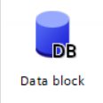
Dynamic vs Static
Java
IEC 61131
With Java, standard variables are defined in the code, they are dynamic.
With IEC 61131-3 standard variables are static, they are defined before the program runs.
Not fully true, but out of the scope of this course.
Static variables have declaration and instanciation in a Data Block DB

Slide 12
Arithmetic operators
Java
IEC 61131
// Multiplication
x = y * z;
// Addition
x = y + z;
// Subtraction
x = y - z;
// Division
x = y / z;
// Modulo
x = y % z;
// Multiplication
x := y * z;
// Addition
x := y + z;
// Subtraction
x := y - z;
// Division
x := y / z;
// Modulo
x := y % z;

Slide 13
Increment operator
Java
IEC 61131
// Pre increment
x = ++y;
// Post increment
x = y++;
// Pre decrement
x = --y;
// Post decrement
x = y--;
// Pre increment
// does not exist
// Post increment
// does not exist
// Pre decrement
// does not exist
// Post decrement
// does not exist

Slide 14
Assignation operators
Java
IEC 61131
// Addition short
x += y;
// Substration short
x -= y;
// …
// Addition short
// does not exist
// Substration short
// does not exist
// …

Slide 15
Binary operators
Java
IEC 61131
// And
result = a & b;
// Or
result = a | b; // Shift Right
result = a >> 1;
// Shift Left result = a << 3;
// And
result := a AND b;
// Or result = a OR b;
// Shift Right result = a SHR 1;
// Shift Left result = a SHL 3;

Slide 16
If… Else…
Java
IEC 61131
if(temp <= 0){
diSet = diHighPower}
else if(temp > 0 && temp < 15){
diSet = diMidPower;}
else{
diSet = diLowPower;}
IF "DB_L".temp <= 0 THEN
"DB_L".diSet := "DB_L".diHighPower;
ELSIF "DB_L".temp > 0 AND "DB_L".temp < 15 THEN
"DB_L".diSet := "DB_L".diMidPower;
ELSE
"DB_L".diSet := "DB_L".diLowPower;
END_IF;
;

Slide 17

switch … case
Java
IEC 61131
switch (theSignal){
case RED:
diVelocity = 0;
break;
case ORANGE:
diVelocity = 30;
break;
case GREEN:
diVelocity = 50;
break;
default:
diVelocity = -1;
break;
}
CASE "DB_L".theSignal OF
1: // Red
"DB_L".diVelocity := 0;
2: // Orange
"DB_L".diVelocity := 30;
3: // Green
"DB_L".diVelocity := 50;
ELSE // Statement section ELSE
"DB_L".diVelocity := -1;
END_CASE;
Enum exists in standard definition of IEC 61131-3
Unfortunately, ENUM does not exist in TIA Portal.

Slide 18

for … FOR
Java
IEC 61131
for (int i = 0; i < 15; i = i + 2){
theSignal++;
}
FOR "DB_L".iLoop := 1 TO 15 BY 2 DO
"DB_L".theSignal := "DB_L".theSignal + 1;
END_FOR;
I never use a variable with a single char like int i.
Because it is difficult to find in the code.
Try to search “i” in your code…
Use iLoop instead.

Slide 19
while … WHILE DO
Java
IEC 61131
while (nCounter != 0) {
nVar1 = nVar1*2;
nCounter--;
}
WHILE nCounter <> 0 DO
nVar1 := nVar1*2
nCounter := nCounter-1;
END_WHILE;
If nCounter = 0, the code inside the loop is never executed.
Note: this example from Beckhoff website is bad ! Could conduct to infinite loop never write that do not use <> !!!

Slide 20
do while … REPEAT UNTIL
Java
IEC 61131
int count = 1;
do {
nVar1 = nVar1*2
count++;
} while (count >= 11);
REPEAT
nVar1 := nVar1*2;
nCounter := nCounter+1;
UNTIL
// from the web = 11
nCounter >= 11
END_REPEAT;
The code inside the loop is executed at least once.
Note: One more time the example from the web was bad!!
But this time I changed it !!!

Slide 21
continue … CONTINUE
Java
IEC 61131
for (int i = 0; i < 15; i = i + 2){
if (i < 5){
continue;
}
theSignal = 1;
}
FOR "DB_L".iLoop := 1 TO 15 BY 2 DO
IF ("DB_L".iLoop < 5) THEN
CONTINUE;
END_IF;
"DB_L".theSignal := 1;
END_FOR;

Slide 22
break … EXIT
Java
IEC 61131
for (int i = 15; i >= 1; i = i - 2){
if (i < 5){
break;
}
theSignal = 1;
}
FOR "DB_L".iLoop := 15 TO 1 BY -2 DO
IF ("DB_L".iLoop < 5) THEN
EXIT;
END_IF;
"DB_L".diSet := 1;
END_FOR;

Slide 23
enum
Java
IEC 61131
enum State{
OPEN, CLOSED, BROKEN
};
TYPE E_TrafficSignal :
(
eRed,
eYellow,
eGreen := 10
);
END_TYPE
;
Enum Exist in standard definition of IEC 61131-3
Unfortunately, ENUM does not exist in TIA Portal.

Slide 24
Class vs Function Block
Java
IEC 61131
public class Rectangle{
int width;
int height;
int surface(){
return width * height;
}
int perimeter(){
return 2*width + 2*height;
}
}
FUNCTION_BLOCK "FB_Rectangle"
VAR_INPUT
diWidth : DInt;
diHeight : DInt;
END_VAR
VAR_OUTPUT
diSurface : DInt;
diPerimeter : DInt;
END_VAR
BEGIN
#diSurface := #diWidth * #diHeight;
#diPerimeter := 2 * #diWidth +
2 * #diSurface;
END_FUNCTION_BLOCK

Slide 25
Function
Un fonction en IEC 61131 est toujours statique !
Java
IEC 61131
public static int abs(int x) {
if (x > 0)
return x;
else
return -x;
}
FUNCTION "FC_abs" : DInt
VAR_INPUT
dix : DInt;
END_VAR
BEGIN
IF #dix > 0 THEN
#FC_abs := #dix;
ELSE
#FC_abs := - #dix;
END_IF;
END_FUNCTION
;
In TIA Portal, VAR_INPUT usually described in a graphical view, a table.
Text view available from V15.1
In TIA Portal, VAR_INPUT BEGIN and END_FUNCTION are hidden.

Slide 26
Class vs TYPE
IEC 61131 InOut
TYPE "Rectangle_typ"
STRUCT
diWidth : DInt;
diHeight : DInt;
diSurface : DInt;
diPerimeter : DInt;
END_STRUCT;
END_TYPE
FUNCTION_BLOCK "FB_Rectangle InOut"
VAR_IN_OUT
param : "Rectangle_typ";
END_VAR
BEGIN
#param.diSurface := #param.diWidth * #param.diHeight;
#param.diPerimeter := 2 * #param.diWidth +
2 * #param.diHeight;
END_FUNCTION_BLOCK
An IEC TYPE is a class without any code.
We can define a Function Block without variables. Passed by reference/address

Slide 27
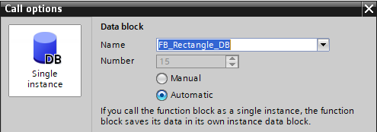
Instantiation
Java declaration + instantiation (reserve memory dynamically).
Java
IEC 61131
// Declaration
Rectangle room;
// Instanciation
room = new Rectangle();
// Use room.witdh = 10;
room.height = 4;
int s = room.surface();
// Declaration + Instanciation
DATA_BLOCK "FB_Rectangle_DB"
NON_RETAIN
"FB_Rectangle"
BEGIN
END_DATA_BLOCK
// Call
"FB_Rectangle_DB"(diWidth:=10,
diHeight:=4);
// Use
"DB_L".diS := "FB_Rectangle_DB".diSurface;
"DB_L".diP := "FB_Rectangle_DB".diPerimeter;
Instantiate memory in a DataBlock. Static memory
Call to compute internal code.
Function Bloc is a method, it does nothing if not called
Unlike Java, does not compute anything, no independent methods

Slide 28
Class vs Function Block
Java
IEC 61131
Class need declaration and instantiation.
Instantiation is dynamic, while program is running.
Objects can have methods.
Function Block need declaration
Instantiation is static, made by automatically by the linker, BEFORE the start of the program.
Function Blocks is a Method. It must be run to compute internal values.

Slide 29
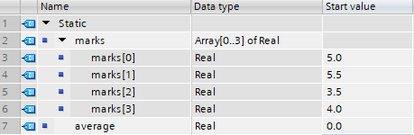
Array
Java
IEC 61131 (declaration)
double[] marks = { 5, 5.5, 3.5, 4 };
double average = 0;
for (int i = 0; i < marks.length; i++) {
average = average + marks[i];
}
average /= marks.length;.
DATA_BLOCK "DBx"
VAR
marks : Array[0..3] of Real;
average : Real;
END_VAR
BEGIN
marks[0] := 5.0;
marks[1] := 5.5;
marks[2] := 3.5;
marks[3] := 4.0;
END_DATA_BLOCK
Declaration, usually done in graphical mode in TIA Portal

Slide 30
Array
Java
IEC 61131 code
double[] marks = { 5, 5.5, 3.5, 4 };
double average = 0;
for (int i = 0; i < marks.length; i++) {
average = average + marks[i];
}
average /= marks.length;.
Damned !

Slide 31
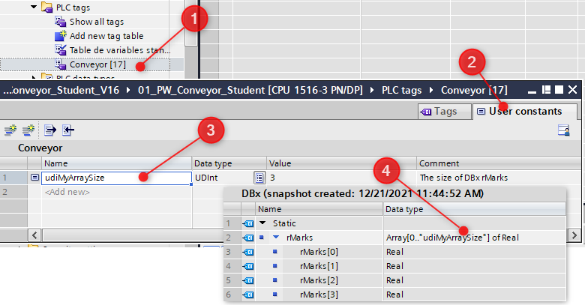
Array length in IEC 61131
IEC 61131
Use a constant to define the length(-1) of your array.

Slide 32
Array length in IEC 61131
IEC 61131
// Note that For...Loop imposes a Int
"DBx".rAverage := 0;
FOR "DBx".iLoop := 0 TO UDINT_TO_INT("udiMyArraySizeNm1") DO
"DBx".rAverage := "DBx".rAverage +
"DBx".rMarks["DBx".iLoop];
END_FOR;
// Note the udiMyArraySizeNm1 is the size - 1
"DBx".rAverage := "DBx".rAverage / UDINT_TO_REAL("udiMyArraySizeNm1"+1);

Slide 33
Dynamic Array length in IEC 61131
IEC 61131 specific to TIA Portal, CountOfElements
FUNCTION "FC_GetArraySize" : Void
VAR_OUTPUT
udiSize : UDInt;
END_VAR
VAR_IN_OUT
vPointer : Variant;
END_VAR
BEGIN
#udiSize := CountOfElements(#vPointer);
END_FUNCTION
"FC_GetArraySize"(vPointer := "DBx".rMarks, udiSize => "DBx".udiArrayLength);

Slide 34
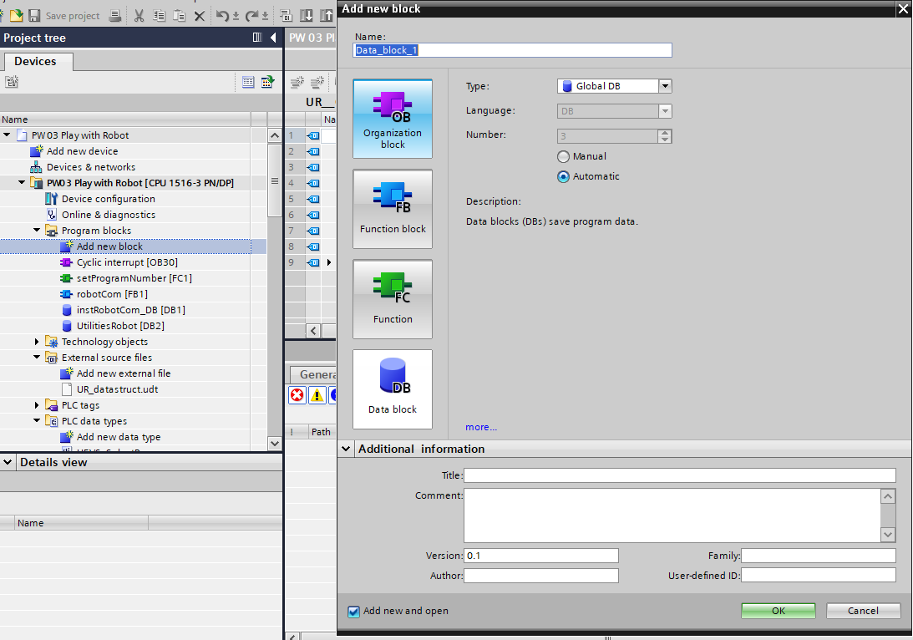
OB FB FC DB
IEC 61131

Slide 35
DB
IEC 61131
A DB is an Object
Memory

Slide 36
FB
IEC 61131
A FB is a Class
Function
Function Block
Data

Slide 37
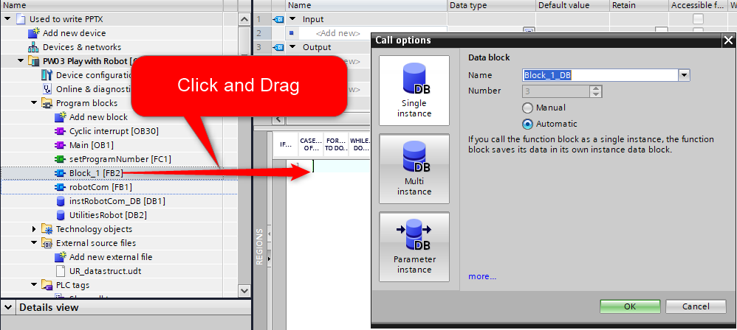
FB call options
IEC 61131
Single instance
The function block saves its data in its own instance data block. (Create an instance)
Multi instance
It saves its data in the instance data block of the calling function block. (Create an instance)
Parameter instance
If you call the function block as a parameter instance, the function block saves its data in the instance you specify as block parameter.
InOut (Does not create an instance !)

Slide 38
In Out InOut
IEC 61131
"FB_PPTX_DB"(myInputValue:="PPTX_DB".TheInputValue,
myOutputValue=>"PPTX_DB".TheOutputValue,
myInOutValue:="PPTX_DB".TheInOutStruct);
In := copy value to FB
Out => copy FB to value
InOut := pass reference to…, that is: address of a variable, structure or FB.

Slide 39
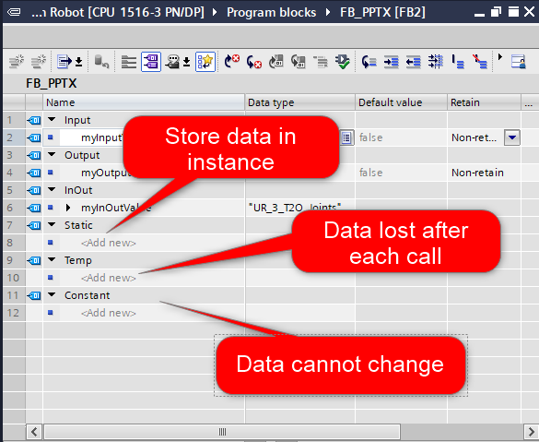
Static Temp Constant
IEC 61131

Slide 40
FC
IEC 61131
A function is a FB without memory
That is: without instance.
From the point of view of a Java programmer, this is a Static Function

Slide 41
Merci de votre attention

